Slide 1

Assignment 1:
Killian Halpin 20093283:
Notes:
1

Slide 2
Criteria for selecting Breaches:
The common vulnerability scoring system is an open framework for deciding the characteristics and severity for software vulnerabilities it consists of three metric groups Base, Temporal and Environmental.
The base score of the CVSS reflects the severity of the vulnerability which are constant overtime,
Temporal Metrics adjusts the Base severity of the vulnerability on factors that change overtime.
Environmental metrics adjusts both base and temporal severities to specific computing environment.

Slide 3
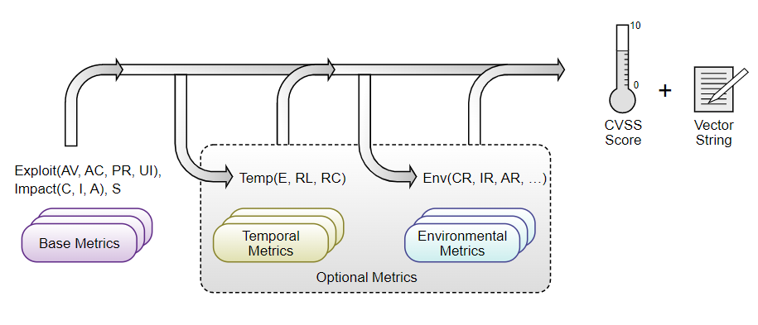
Scoring:
When the base metrics are assigned values the equation gives it a score between 0 and 10.
10 is the highest threat level while 0 is no threat.
There could be many people doing this matric scoring, but the scoring is intended to be agnostic to the individual and their organisation.
All matrices should he scored with the assumption that the attacker has already found the vulnerability.
For a breach to be considered most important there are many metrics it must go through to test whether the threat is of importance or not.

Slide 4
Breaches:
The two Breaches I decided to do are
Nintendo NNID Hack and ,
Solar Winds Orion attack.

Slide 5
Solar Winds Orion:
The attackers managed to infect the software updates custom-built malware which created a backdoor access into aby system which downloaded the updates.
It affected 18,000 high value targets including,
Every US Government agency,
CISCO system and
Microsoft system.
Executed by Russias Foreign Intelligence Service.

Slide 6
Nintendo NNID Hack:
On the 24th of April 2020 Nintendo suffered an attack.
They got in using the NNID which was vulnerable as it didn’t have 2 factor Authentication.
The attack affected 300,000 accounts.
data that was compromised included nickname, date of birth, country region and e-mail were revealed.
Some Credit card information was revealed including card type and currency, expiration date first 6 digits and also the last 4 digits of the card were leaked.
The attack was carried out using credential stuffing and also a custom-made program.
The program used custom-made account checker made specifically for Nintendo accounts.

Slide 7
About the code:
The program had a defence feature. It would only let the attacker use it and no one else
The code would not work without payment, and it would only work on one computer
There was also a built-in kill switch if it detected debugging tools being used
The source code used proxies to hide the IP of the hacker
In order for the code to work the hacker had to provide it with passwords which were acquired from other data breaches. These data breaches could have happened years ago and there was a possibility that they still might have worked.

Slide 8
Fix:
The Nintendo NNID breach could have been easily avoided if two factor authentication had been in place.
It could also have been avoided if Nintendo applied a stricter password policy making their passwords 8 characters instead of 6. This would have led to much stronger passwords and less chance the attacker could have gained access to their accounts.

Slide 9
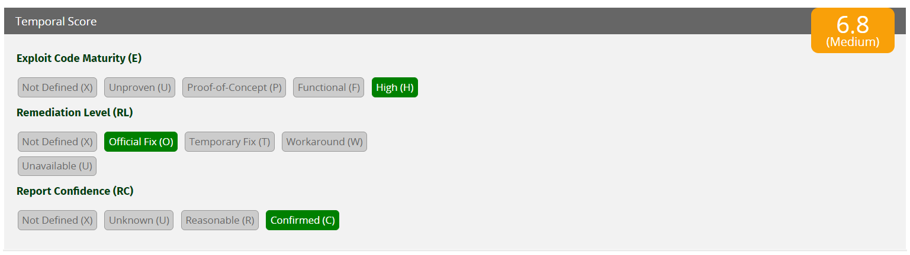
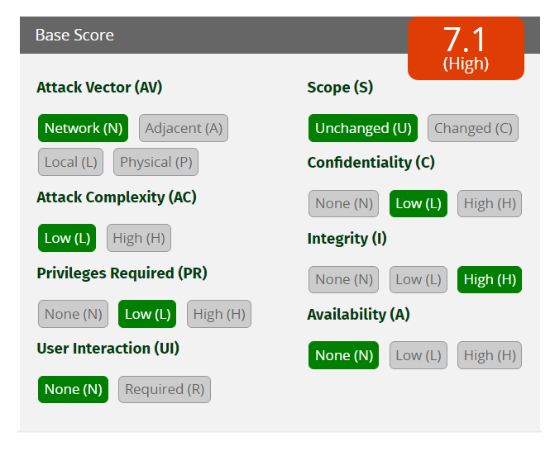
Results:
In the end the threat generated a 7.1 base score and a temporal score of 6.8
The threat turned out to be a medium.

